Slide 1
EIA as an Environmental Management Tool
Mrs. Amrutha S
A.P, CED

Slide 2
EIA:
An assessment of the impact of a planned activity on the environment
EIA is a planning tool used to predict and evaluate the potentially significant impacts of proposed action and provide a mitigation plan for minimizing adverse impacts for making decision on the proposed project/ program/policy

Slide 3
Ministry of Environment & Forests (MoEF), Government of India defined Environmental impact assessment (EIA) as a process of identifying, predicting, evaluating, and mitigating the biophysical, social, and other relevant effects of proposed projects and physical activities prior to major decisions and commitments being made.

Slide 4
Salient features of EIA
It identifies the possible positive and negative impacts which may be short term and long term.
It provides a plan which will reduce the negative impacts of a project. This plan may be a project alternative or project modification or environmental protection measures which reduces negative impacts.
It measures the level of plan implementation and the degree of effectiveness of environmental protection measures.

Slide 5
Purpose/Need of EIA
When a new project starts in an area, it will disturb the environmental equilibrium, so that EIA is necessary to know whether the project should be started or not.
To maintain quality of environment it is essential to study impacts of project on environment.
EIA also suggests remedial measures for the pollution caused by the project, thereby we can implement pollution control methods (e.g. Treatment units) along with the project.
The opinion of public is considered for conducting EIA, so the decision taken about the commencement of new project will be more environment friendly.

Slide 6
Goals of EIA
Resources conservation
Waste minimization
Recovery of by-products
Efficient use of equipment
Sustainable development

Slide 7
EVOLUTION OF EIA
In Global Scenario (Evolution of EIA worldwide)
First introduced in United States of America through its National Environmental Protection Act (NEPA) of 1969.(legislative basis for EIA)
Canada, Australia, the Netherlands and Japan adopted EIA legislation in 1973, 1974, 1981 and 1984, respectively.
In July 1985, the European Community issued a directive, making environmental assessments mandatory for certain categories of projects.
In Asia and the Pacific region, Thailand and the Philippines have long established procedures for EIA.
EIA was made mandatory in Sri Lanka in 1984.
The EIA process in Africa is sketchy, although a number of nations including Rwanda, Botswana and Sudan have some experience of EIA.

Slide 8
The Organisation for Economic Co-Operation and Development (OECD) issued recommendations on EIA to its constituent States in 1974 and 1979, and for development aid projects in 1986. OECD issued guidelines for good practices in EIA in 1992
United Nations Environment Programme (UNEP) in 1980 provided guidance on EIA of the development proposals and supported research on EIA in developing countries. UNEP, in 1987, set out goals and principles of EIA for the member countries and provided guidance on basic procedures for EIA in 1988.
The World Conservation Strategy pinpointed the need to integrate environmental considerations with development in 1980.
EIA became an integral part of World Bank policy in 1987.
Asian Development Bank in 1990 published guidelines for EIA Importance.

Slide 9
In Indian Scenario
Concept of EIA-Environmental Impacts associated with river valley project
Environmental (Protection) Act 1986, empowered Central Government to introduce requirement of formal EIA procedure prior to clearance for the projects likely to have significant environmental impacts.
Restricting location of industries, mining operations and regulating other activities in Doon Valley (1st February 1989).
Regulating activities in the coastal stretches of the country by classifying them as coastal regulation zone and prohibiting certain activities (19th February 1991).

Slide 10
Restricting location of industries and regulating other activities in Dahanu Taluka (forest land, mangroves) in Maharashtra (6th June 91).
Restricting certain activities in specified areas of Aravalli Range in the Gurgaon district of Haryana and Alwar district of Rajasthan (7th May 1992).
Restricting industrial and other activities, which could lead to pollution and congestion in the north west of Numaligarh in Assam (July 1996).
EIA notification1994 making environmental clearance mandatory for projects listed in schedule I & revised the EIA notification in September 2006.

Slide 11
EIA notification 1994
Schedule I: List of projects requiring environmental clearance from the central government- Nuclear Power Projects, River Valley Projects, Harbours, Ports, Petroleum Refineries etc.
Schedule II: Application form for Environmental clearance to the MoEF along with necessary documents.
Schedule III: Composition of Expert committee for giving Environmental clearance-consisting of 15 members from various disciplines-reconstituted after every three years
Schedule IV: Procedure for public hearing-SPCB or concerned District Collector will conduct public hearing

Slide 12
2006 EIA Government of India notification
List of developmental projects and activities which require prior environmental clearance (given in Schedule I) was expanded.
A State level Environmental Impact Assessment Authority (SEIAA) consisting of three members to be constituted by the Govt. of India
All developmental projects requiring prior environmental clearance (given in Schedule I) categorized under two heads-based on potential impact
Expert committee (EC) as per 1994 EIA Notification was re-designed as Expert Appraisal Committee (EAC) as per 2006 EIA Notification.

Slide 13
All Projects and activities given in Schedule Il
CATEGORY A (comes under MoEF)
CATEGORY B (comes under the SEIAA)
CATEGORY B1 (Projects requiring EIA clearance)
CATEGORY B2 (Projects which do not require EIA clearance)

Slide 14
The Air (Prevention and Control of Pollution) Act of 1981 and amendment,1987
To implement the decisions taken at the United Nations Conference on the Human Environment held at Stockholm in June 1972, Parliament enacted the nationwide Air Act
The main objectives of this Act are to improve the quality of air and to prevent, control and abate air pollution in the country
To enable an integrated approach to environmental problems, the Air Act expanded the authority of the central and state boards established under the Water Act, to include air pollution control.
Under the Air Act, all industries operating within designated air pollution control areas must obtain a “consent” (permit) from the State Boards.

Slide 15
States not having water pollution boards were required to set up air pollution boards
The states are required to prescribe emission standards for industry and automobiles after consulting the central board and noting its ambient air quality standards.
Act granted the power of entry for examination, testing of equipment and other purposes and power to take the sample for the purpose of analysis of air or emission from any chimney, fly ash or dust or any other outlet in such a manner as may be prescribed
Aboard may also apply to the court to restrain emissions that exceed prescribed limits.Notably, the 1987 amendment introduced a citizen’s suit provision into the Air Act and extended the Act to include noise pollution.

Slide 16
The Water (Prevention and Control of Pollution) Act of 1974 and Amendment, 1988
The main objective of this act is to provide prevention and control of water pollution and maintaining or restoring of wholesomeness and purity of water (in the streams or wells or on land)
The Act vests regulatory authority in State Pollution Control Boards and empowers these Boards to establish and enforce effluent standards for factories discharging pollutants into water bodies.
A Central Pollution Control Board performs the same functions for Union Territories and formulate policies and coordinates activities of different State Boards.
The State Pollution Control Boards control sewage and industrial effluent discharges by approving, rejecting or impose conditions while granting consent to discharge.
The Act grants power of entry for examination, testing of equipment and other purposes and power to take the sample for the purpose of analysis of water from any stream or well or sample of any sewage or trade effluents.

Slide 17
The 1988 amendment strengthened the Act’s implementation the pollution provisions. Board may close a defaulting industrial plant or withdraw its supply of power or water by an administrative order; the penalties are more stringent, and a citizen’s suit provision supports the enforcement machinery

Slide 18
The Environment (Protection) Act of 1986
In the wake of the Bhopal tragedy, the government of India enacted the Environment (Protection) Act of 1986
The purpose of the Act is to implement the decisions of the United Nations Conference on the Human Environment of 1972, relate to the protection and improvement of the human environment and the prevention of hazards to human beings, other living creatures, plants and property.
The Act is an “umbrella” for legislations designed to provide a framework for Central Government, coordination of the activities of various central and state authorities established under previous Acts, such as the Water Act and the Air Act.
In this Act, main emphasis is given to “Environment”, defined to include water, air and land and the inter-relationships which exist among water, air and land and human beings and other living creatures, plants, micro-organisms and property.

Slide 19
“Environmental pollution” is the presence of pollutant, defined as any solid, liquid or gaseous substance present in such a concentration as may be or may tend to be injurious to the environment.
“Hazardous substances” include any substance or preparation, which may cause harm to human beings, other living creatures, plants, microorganisms, property or the environment.
Section 3 (1) of the Act empowers the Centre to “take all such measures as it deems necessary or expedient for the purpose of protecting and improving the quality of the environment and preventing, controlling and abating environmental pollution”.
The Central Govt. is authorized to set new national standards for the quality of the environment (ambient standards) as well as standards for controlling emissions and effluent discharges.
Also, the act authorize the Central Govt. to regulate industrial locations, to prescribe procedures for managing hazardous substances; to establish safeguards preventing accidents, and to collect and dismantle information regarding environmental pollution.

Slide 20
By virtue of this Act, Central Government has armed itself with considerable powers which include, coordination of action by state, planning and execution of nation wide programs, laying down environmental quality standards, specially those governing emission or discharge of environmental pollutants, placing restriction on the location of industries and so on.
The coverage of powers include handling of hazardous substances, prevention of environmental accidents, inspection of polluting units, research, establishment of laboratories, dissemination of information, etc.
The Act provides provision for penalties. Any person who fails to comply with any of the provisions of the Act, or the rules, orders, or directions issued under the Act shall be punished.
The Environment (Protection) Act contains significant innovations for its enforcement,not contained in any other pollution control legislation at the time of the Act’s adoption.

Slide 21
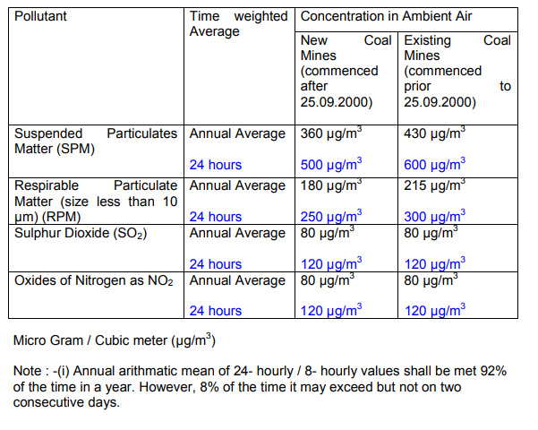
i. AIR QUALITY STANDARDS:

Slide 22
In case of residential or commercial or industrial place falls within 500 m of any dust generating sources, the National Ambient Air Quality Standards shall be made applicable

Slide 23
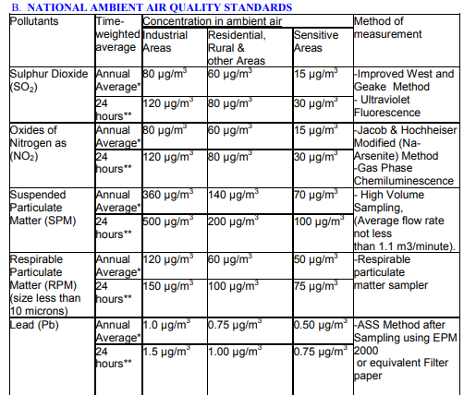

Slide 24
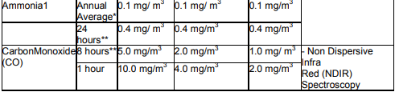

Slide 25
NOISE LEVEL STANDARDS:
Standards Time duration: 6.00 A.M.- 10.00 P.M. 10.00 P.M. - 6.00A.M
Noise Level: Leq 75 dB(A) Leq 70 dB(A)
Note : decibel (dB)

Slide 26
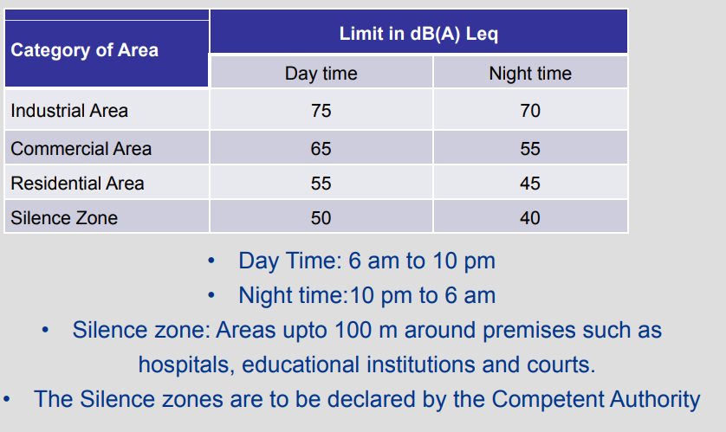

Slide 27
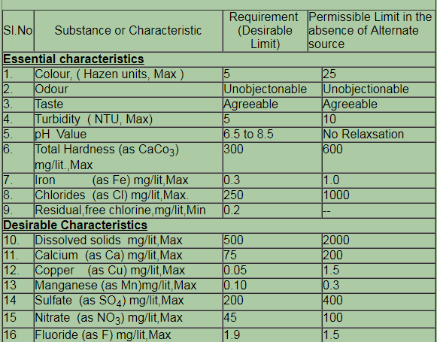
INDIAN STANDARDS FOR DRINKING WATER -SPECIFICATION ( BIS 10500 : 1991 )

Slide 28
